Slide 1
11/18/2024
Today’s lecture is intended to help you achieve the following learning objective: Explain the concept of regions related to a QM/MM calculation. Compare and contrast QM/MM with molecular mechanics.
Molecular Mechanics Force Fields
Quantum Mechanics versus Molecular Mechanics
Differences between molecular mechanics and quantum mechanics?
Quantum Mechanics/Molecular Mechanics calculations
The 2013 Nobel Prize in Chemistry
How do hybrid calculations overcome the limitations of QM and MM?
The QM/MM Hamiltonian
Factors in selecting the QM region
QM/MM exercise

Slide 2
Molecular Mechanics Force Fields

Slide 3
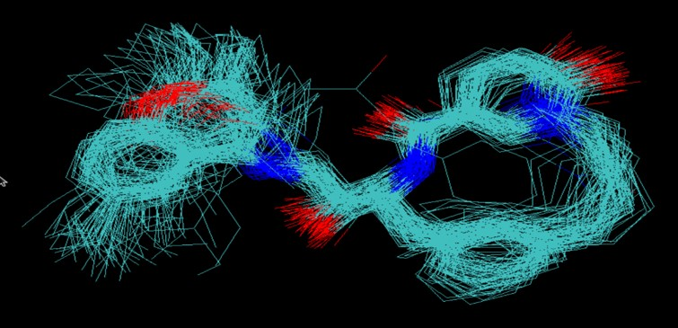
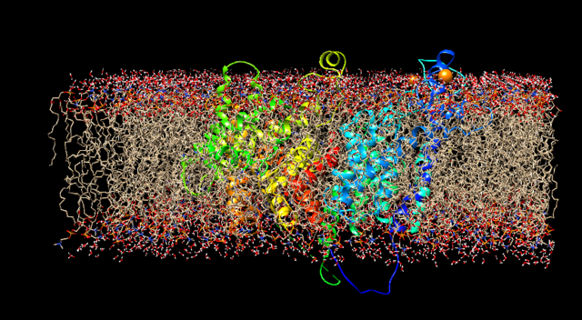
What are molecular mechanics force fields?
E(x) - an equation describing the energy of a configuration of particles
Input: positions of particles in a system
particles are usually atoms, but can be
collections of atoms (e.g. amino acid) in coarse-grained force fields
electrons pairs in a Drude oscillator model
Output: potential energy
Some systems described by molecular mechanics
Configurations of an organic molecule
NaNQR in a membrane

Slide 4
How are they useful?
Energy optimization provides reasonable structures
Helpful for building models that fit to experiment. AMBER (Assisted Model Building with Energy Refinement) is a popular force field.
Basis for many scoring functions in molecular docking.
Gradients are helpful for optimization and to calculate forces in molecular dynamics simulations
According to the Boltzmann distribution, energies specify probabilities, $p(x)∝e^{-βE(x)}$.

Slide 5
What are they made of?
From Figure 3 of
Durant and McCammon, 2011
The potential energy of a system can be divided into those caused by interactions between atoms that are chemically bonded to one another and those caused by interactions between atoms that are not bonded. Chemical bonds and atomic angles are modeled using simple springs, and dihedral angles (that is, rotations about a bond) are modeled using a sinusoidal function that approximates the energy differences between eclipsed and staggered conformations. Non-bonded forces arise due to van der Waals interactions, modeled using the Lennard-Jones potential, and charged (electrostatic) interactions, modeled using Coulomb's law.
Taken from Figure 3 of Durrant & McCammon, 2011.

Slide 6
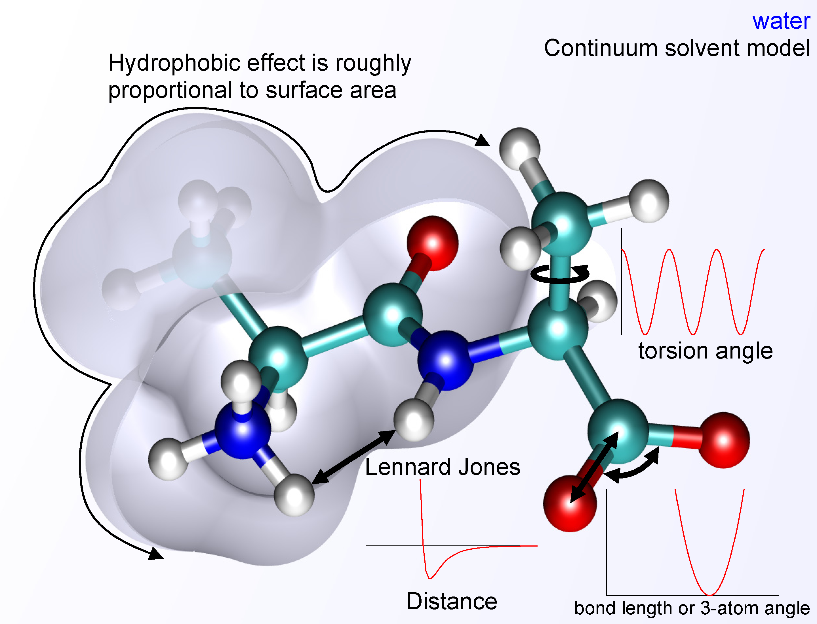
Bonded Interactions
are between atoms that are covalently linked by three or fewer bonds
$$E_{bonds}=\overset{Bonds}{\underset{i}{∑}}\frac{k_{i}}{2}{\left(x_{i}-x_{i,o}\right)}^{2}$$
$$E_{angles}=\overset{Angles}{\underset{i}{∑}}\frac{k_{i}}{2}{\left(ω_{i}-ω_{i,o}\right)}^{2}$$
$$E_{torsions}=\overset{Torsions}{\underset{i}{∑}}\frac{V_{i}}{2}\left[1+cos(n_{i}ϕ_{i}-γ_{i})\right]$$
$$E_{bonded}=E_{bonds}+E_{angles}+E_{torsions}$$

Slide 7
Nonbonded Interactions
are between atoms that are not covalently linked or linked by more than three bonds
$$E_{Coloumbic}=\sum_{i,j}^{Atomswithi<j}{\frac{q_{i}q_{j}}{εR_{i,j}}}$$
$$E_{Lennard−Jones}=\sum_{i,j}^{Atomswithi<j}{\frac{A_{i,j}}{{R_{i,j}}^{12}}−\frac{B_{i,j}}{{R_{i,j}}^{6}}}$$
based on $4ϵ\left[{\left(\frac{σ}{r}\right)}^{12}-{\left(\frac{σ}{r}\right)}^{6}\right]$
$E_{Non−Bonded}=$ $E_{Coloumbic}+E_{Lennard−Jones}$
https://gpantel.github.io/computational-method/LJsimulation/

Slide 8
Where do parameters come from?
QM + experiment
AMBER (as discussed in Tian 2020)
“we also included in ff14SB a small empirical adjustment to ff99SB (using TIP3P water) to improve agreement with NMR data for short alanine peptides”
Quantum chemistry data in implicit solvent (opposed to gas)
OpenFF 2.0.0 (https://openforcefield.org/force-fields/force-fields/)
A select set of the vdW parameters were trained against a set of experimental mass density and enthalpy of mixing measurements sourced from the NIST ThermoML archive.
A select set of the bond length, bond force constant, equilibrium angle, angle force constant and torsion barrier height parameters were trained against a set of QC computed optimized geometries and torsion profiles, whereby the output force field of the first step was used as the starting point.

Slide 9
Molecular Mechanics versus Quantum Mechanics

Slide 10
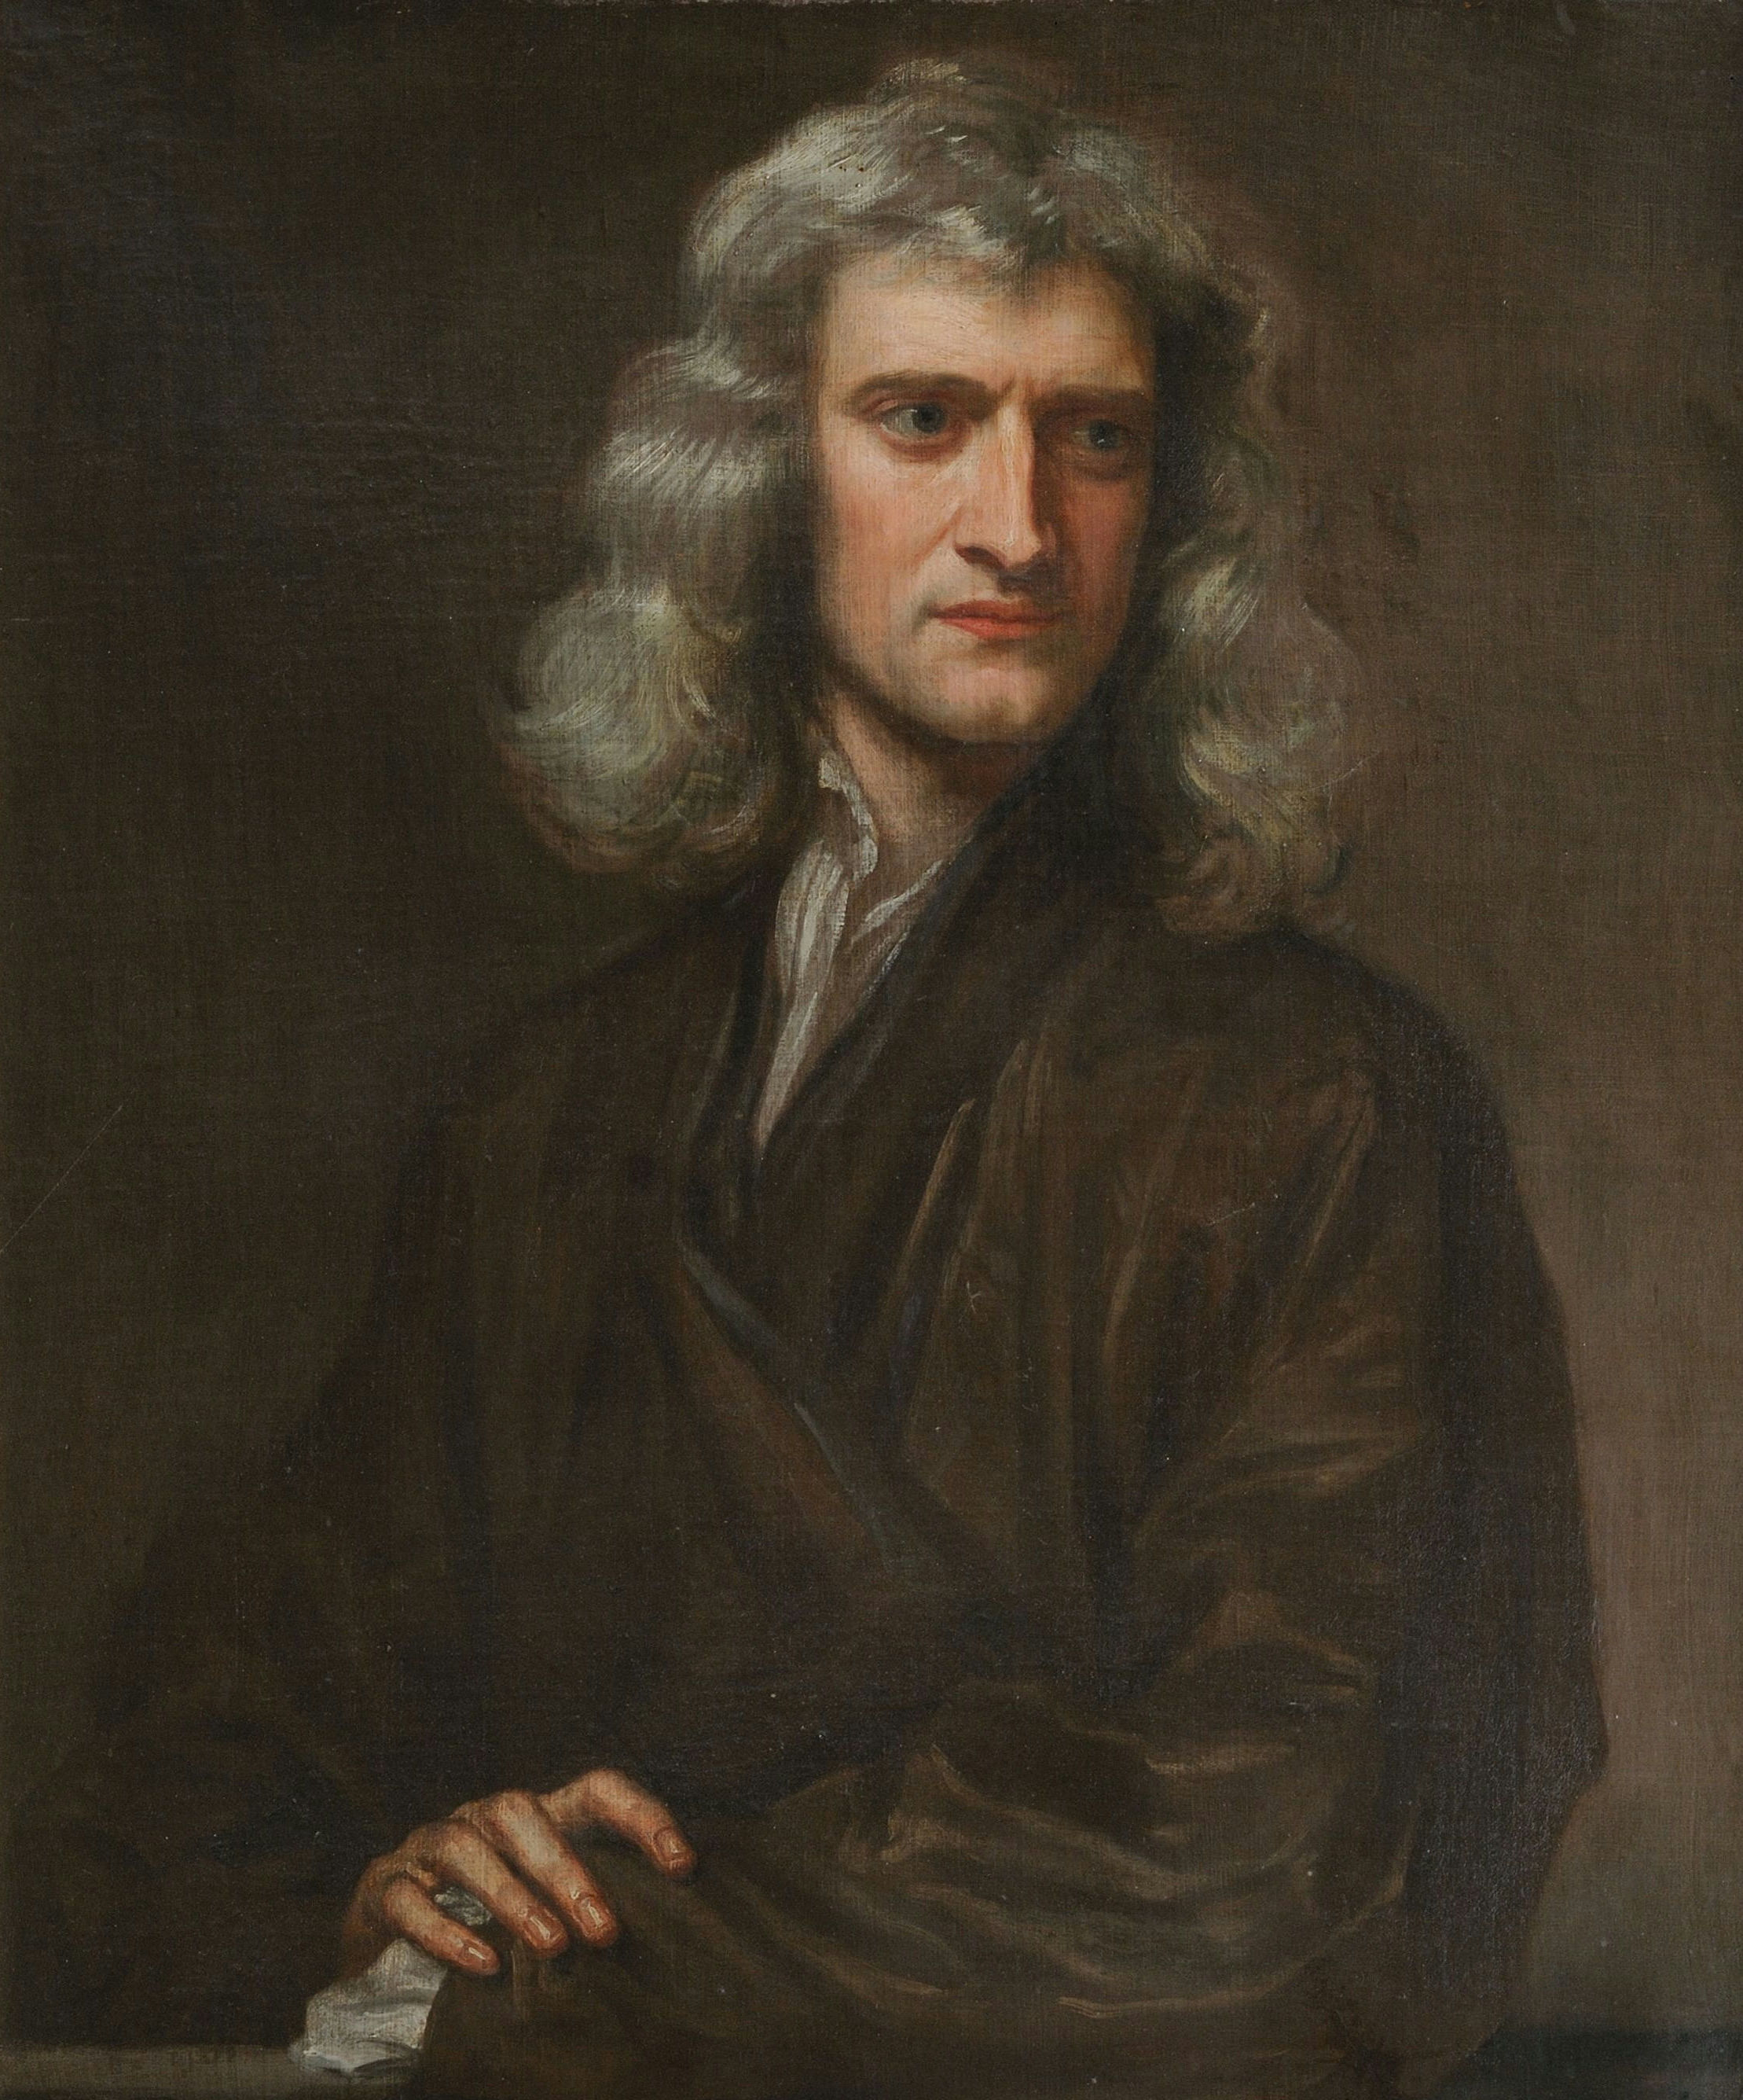
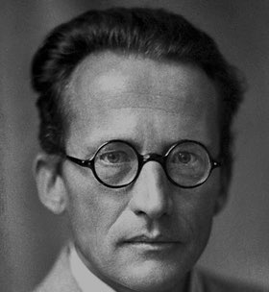
Molecular mechanics vs Quantum mechanics
inputs
coordinates
force field functions
force field parameters, including partial charge
outputs
energy
electron density (from coordinates and partial charge)
fast approximation to QM
energy is differentiable
inputs
coordinates
net charge
total spin
basis set
outputs
energy
wave function, which yields electron density and other properties
highly accurate in gas phase
philosophically confusing

Slide 11
Property | MM | QM
Separate models of nuclei and electrons |  | X
Energy depends on nuclei not electron positions | X
Faster | X
Electrons may be delocalized |  | X
Explicit electron – electron interactions |  | X
Differentiable energy function facilitates optimization and molecular mechanics | X
More complex function guarantees more accuracy |  | X

Slide 12
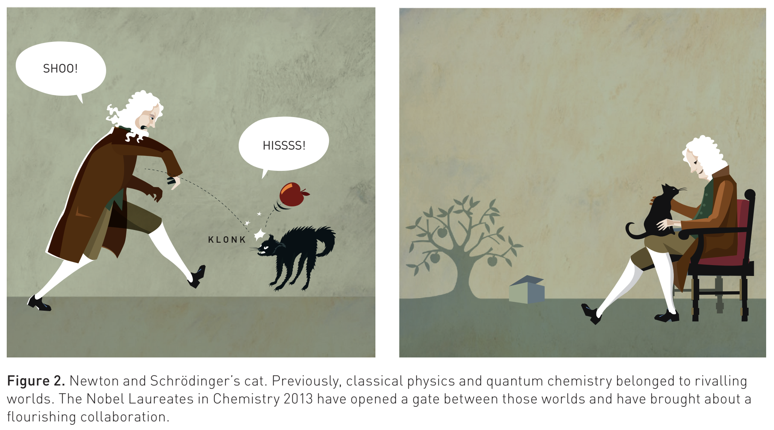
Quantum Mechanics / Molecular Mechanics
https://www.nobelprize.org/uploads/2018/06/popular-chemistryprize2013.pdf

Slide 13

https://www.nobelprize.org/prizes/chemistry/2013/summary/

Slide 14
Overcoming Limitations
QM is accurate but too slow for more than a few hundred atoms, even with modern supercomputers
MM does not model
chemical reactions
electronic processes such as charge transfer / electronic excitation
The QM/MM compromise
QM within a chemically active region
MM for the surroundings
QM:
inner
region
MM: outer region

Slide 15
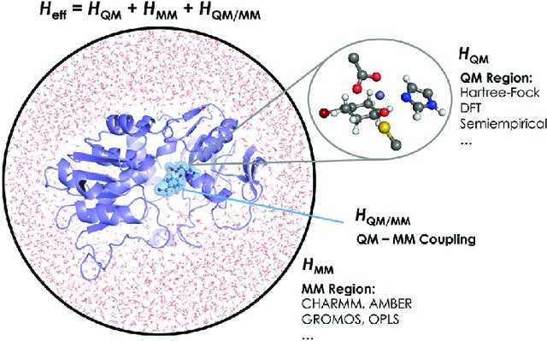
The QM/MM Hamiltonian
QM region
MM region
Coupling
bonded and vdW (Lennard-Jones)
electrostatic between point charges in MM region and
point charges assigned to atoms in the QM region or
expectation value of electrostatic potential energy
Chemical Communications, 53(2), pp.284-297.

Slide 16

The difference in the electronic probability density is plotted. Blue and red contours illustrate the gain and loss of the electronic probability density due to the embedding field.
Polarization energy compared to binding energy for 286 complexes

Slide 17
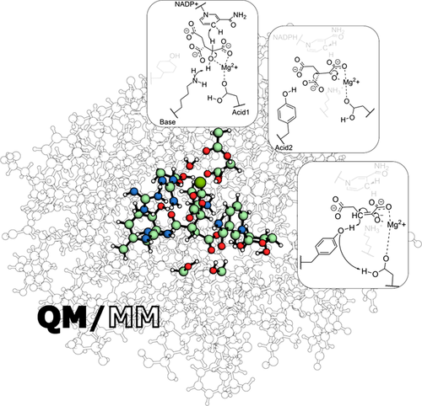
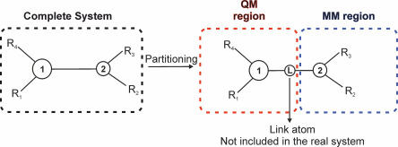
The Boundary
The boundary between QM and MM regions should be
far away from the reactive center
not involve bond formation and bond breaking
Bonds across regions can be capped (CA-CB -> CB-H), but complete molecules preferable
Sousa, S., Ribeiro, A., Neves, R., Brás, N., Cerqueira, N., Fernandes, P. and Ramos, M., 2016. Application of quantum mechanics/molecular mechanics methods in the study of enzymatic reaction mechanisms. WIREs Computational Molecular Science, 7(2).
Navizet, I., 2020. QM/MM Study of Bioluminescent Systems. Challenges and Advances in Computational Chemistry and Physics, pp.227-270.

Slide 18

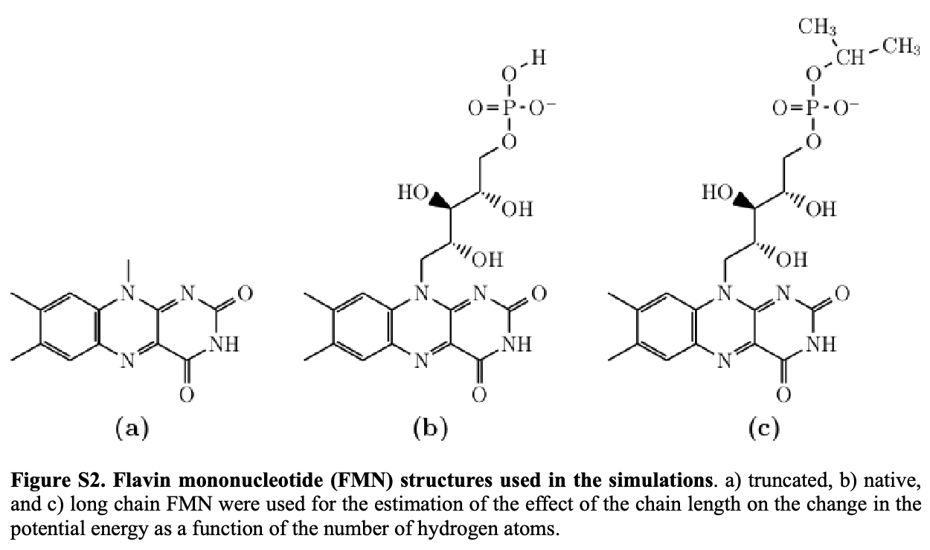
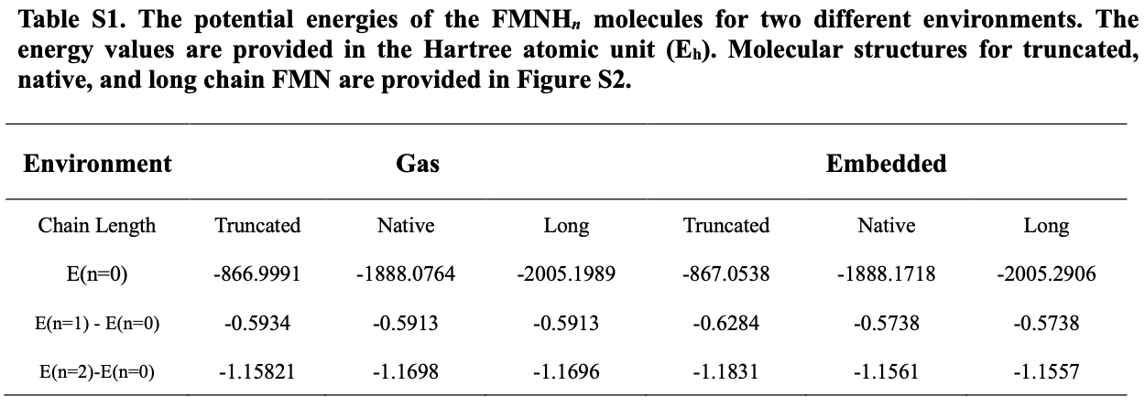
Is the covalent
bond important?
Is the chain
important?
Implicit solvent
FMNB
FMNC

Slide 19
Review questions
What is the difference between a QM calculation in gas versus in a region within a protein?
Describe a way to handle a covalent bond between the QM and MM region of a QM/MM calculation.
In a QM/MM calculation, how can we tell whether the QM region is large enough?

